Slide 1
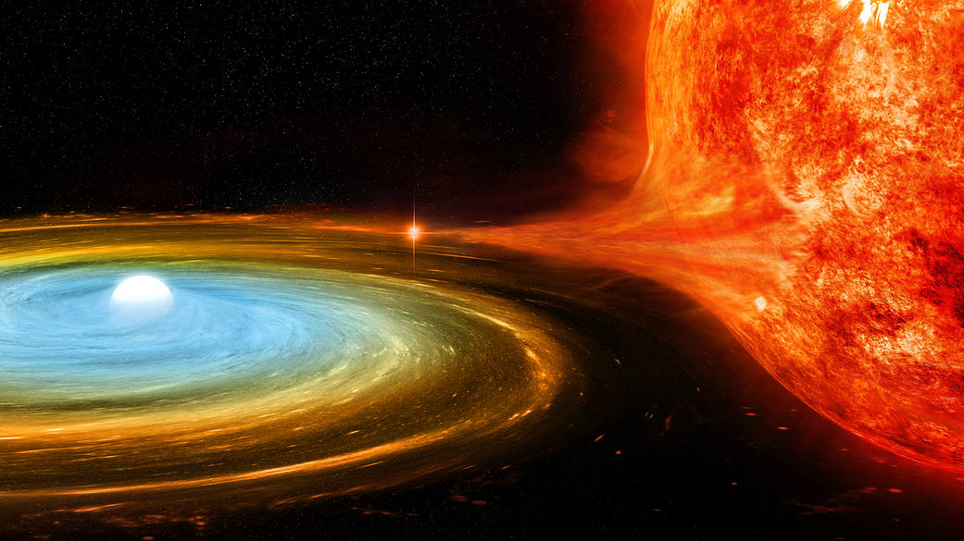
White Dwarfs: Treasure Troves with Galactic Implications
Jacob Christensen

Slide 2
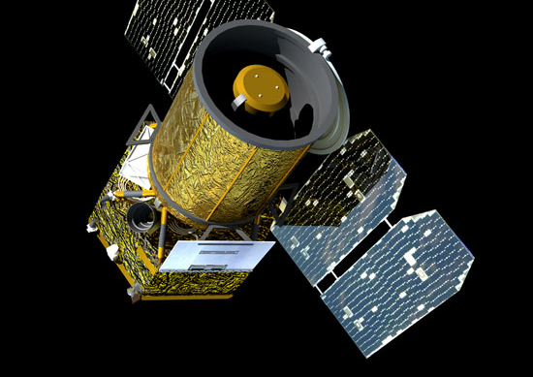
Old, But Still Relevant
Look through past GALEX data (2003-2012)
White Dwarfs—Old, but not actively dead yet!
Variability in Magnitude and Spectra
Atmospheric instability
Eclipse
Planetary Interaction

Slide 3
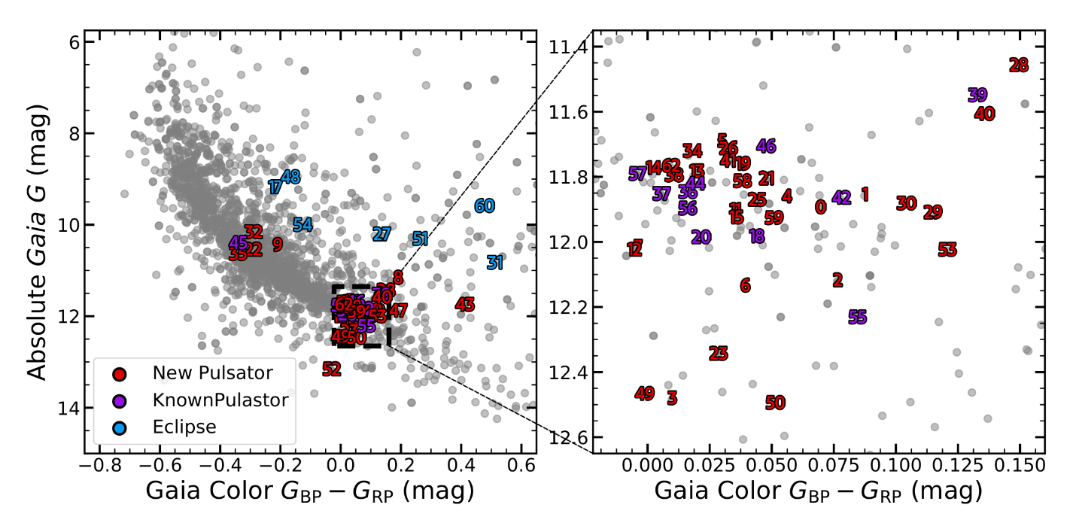
The Data
63 variables, all captured
in ultraviolet
White Dwarf Classification
DA—Hydrogen emission
DB—Helium emission
Binaries: Extra star, more light

Slide 4
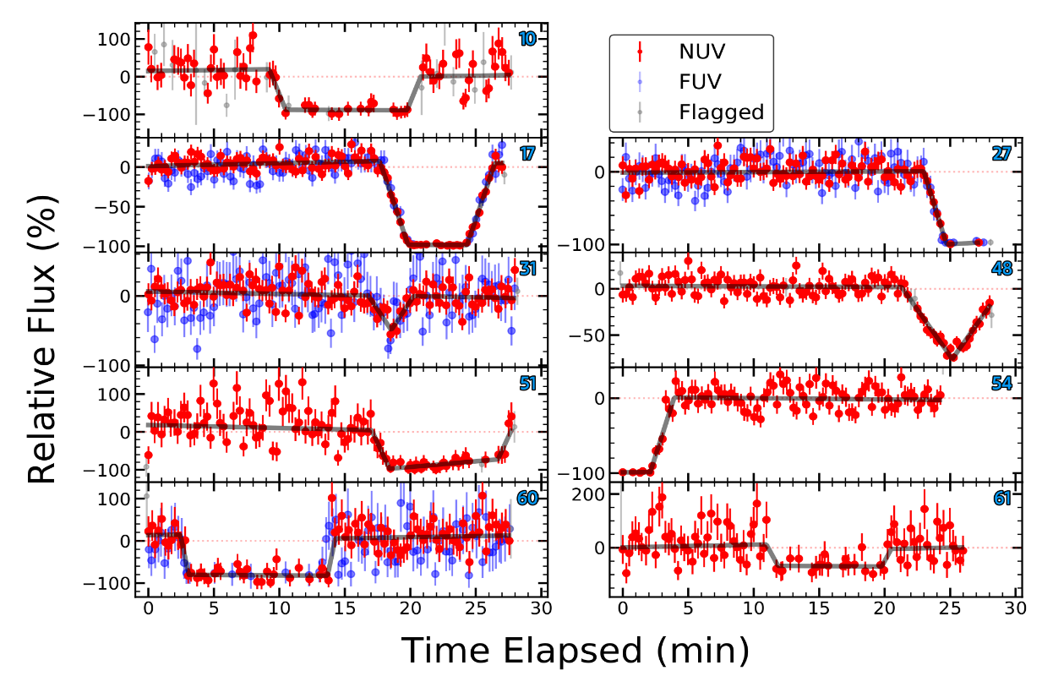
Pin Down Those Parameters
Eclipsing Binaries
Find Mass, Radius
Radial Velocities
Kepler’s Third Law
Eclipsing Times

Slide 5
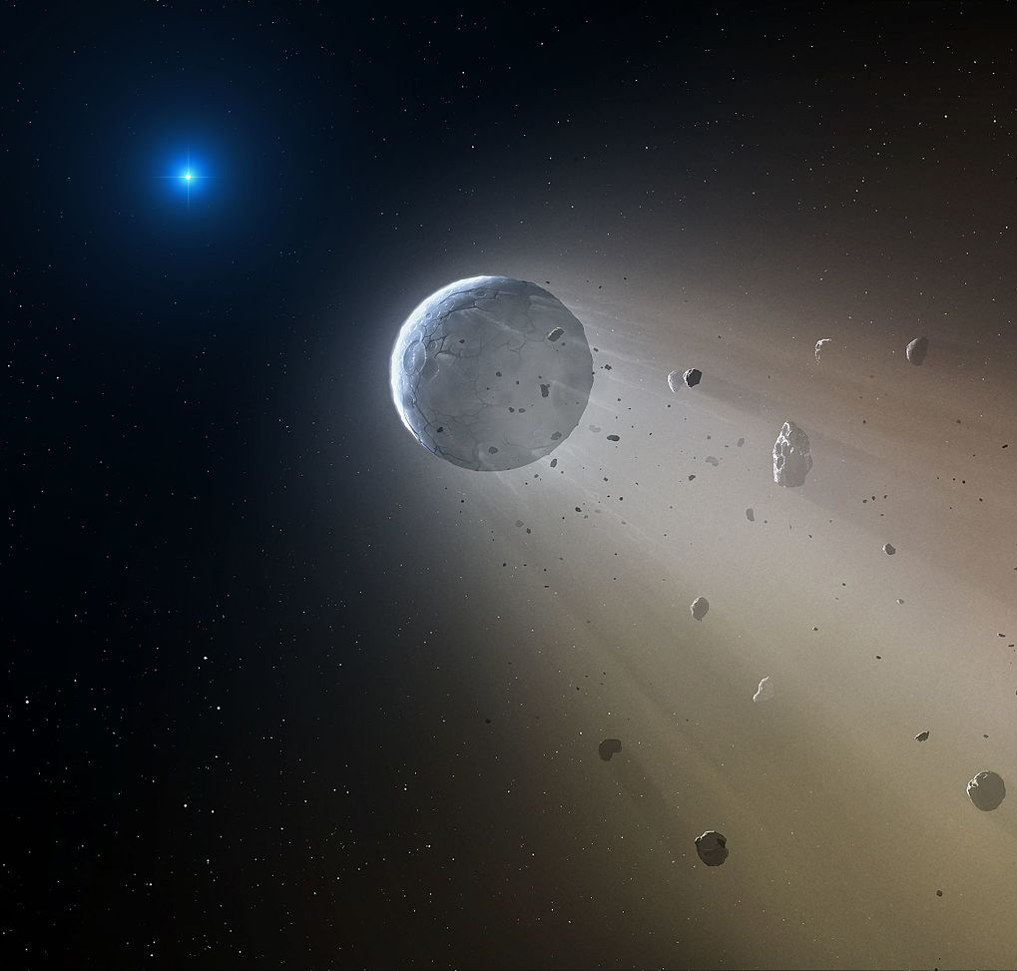
Debris in the Atmosphere
Spectra reflects planetary material
The fate of the Solar System?

Slide 6
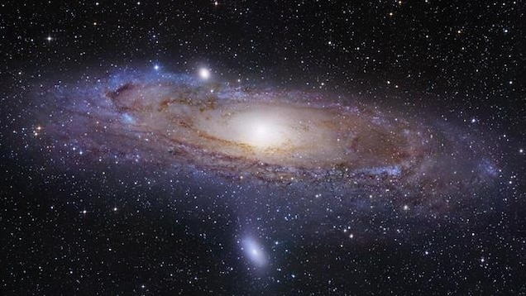

Pulsation Periods are the Key
Give detailed look at interior structure
Like Onions, stratification
The future and the past?

Slide 7
Citations
Original Paper: https://arxiv.org/abs/1812.05614
Astrobite: https://astrobites.org/2018/12/19/galex_wds/
Graphs from Astrobite: https://astrobites.org/2018/12/19/galex_wds/
Images:
https://www.nasa.gov/mission_pages/chandra/images/double-trouble-a-white-dwarf-surprises-astronomers.html
https://www.explore-exoplanets.eu/resource/galex/
https://exoplanets.nasa.gov/news/221/kepler-catches-white-dwarf-cannibalizing-tiny-planet/
https://scitechdaily.com/gaia-reveals-for-the-first-time-crystallization-in-white-dwarfs/
https://www.nationalgeographic.com/science/article/milky-way-galaxy-facts-black-hole-stars-space-science

